Slide 1
ME759 High Performance Computing for Applications in Engineering [Spring 2020]
Lecture 13
02/21/2019
Dan Negrut, 2020 ME759 UW-Madison

Slide 2
Quote of the day
“Let yourself be silently drawn by the strange pull of what you really love. It will not lead you astray.”
-- Rumi, Persian poet [1207 (Afghanistan) – 1273 (Turkey)] – the best selling poet in the US in 2017.

Slide 3
Before we get going…
Last time:
Wrap up memory ecosystem
Shared memory issues
Good global memory accesses
Discussion of parallel computing hazards: RAW, WAW, etc.
Memory consistency model
The use of thread fences & volatile
Today:
Memory aspects: speed issues
Atomic operations
Case study: a reduction operation on the GPU
Other tidbits:
Assignment due tonight at 9 pm
Please read assigned readings
Dan also has office hours online in Canvas each Wd at 7 PM
Next time:
Quick discussion about Final Project proposal
__device__ volatile int X = 1, Y = 2;
__device__ void writeXY()
{
X = 10;
Y = 20;
}
__device__ void readXY()
{
int A = Y;
int B = X;
}

Slide 4
Landmines everywhere???
Is parallel computing riddled with landmines all over the place?
If same memory location gets accessed by different threads: keep your eyes peeled
Up to you to take necessary steps to ensure proper sequence in memory operations (RAW, WAW, WAR)
The tools of the trade (or “tools of the thread”?):
Use of volatile qualifier
Memory fences
Thread synchronization
Note: this transcends GPU computing, applies equally well to multi-core parallel computing

Slide 5
Ruminations, memory related
Ruminations, on two topics
Memory operations, getting the result right (broad discussion, for parallel computing)
Memory operations, getting the result fast (narrower discussion, for GPU computing)

Slide 6
Memory Access Issues
Issue 1: Not all global memory accesses are equally efficient
How can you optimize memory access?
Question is highly relevant (for fast execution)
Issue 2: Not all shared memory accesses are equally efficient
How can we optimize shared memory accesses?
Moderately relevant question
Discussed already, bottom line: avoid bank conflicts
NOTE: Getting global memory access right has higher priority
Notes:
We discuss the 1st one:
scheduling is important here
We do not discuss the 2nd one:
physical layout of the memory banks used for L1 cache / ShMem
bank conflicts

Slide 7
Data Access “Divergence”
Concept is similar to thread divergence and often conflated
Hardware is optimized for accessing contiguous blocks of global memory when performing loads and stores
“block of global memory”: a 128-byte aligned chunk of 128 byte of memory
Becomes a GPU cache line, once it gets read in L2 (and possibly L1) memory

Slide 8
Global Memory Access
Two aspects of global memory access are relevant when fetching data into shared memory and/or registers
The layout of the access to global memory (the pattern of the access)
The alignment of the data you try to fetch from global memory
IMPORTANT:
The two attributes in red above should be interpreted in the context of a memory transaction carried out by one warp of threads
Notes:
Recall: most programs are memory-bound, flops are cheap
Memory transactions are playing key role in the performance of your code. Getting maximum memory throughput requires you to follow certain access pattern rules.
Data “divergence”: concept similar to thread divergence
hardware is optimized for so-called coalesced memory transactions (accessing contiguous blocks of global memory)
divergence: neighboring threads access memory locations physically far from each other

Slide 9
Comment, on the “layout of the access” attribute
The basic idea:
Suppose each thread in a warp accesses a global memory address for a load operation at some point in the execution of the kernel
These threads can access global memory data that is either (a) neatly grouped, or (b) scattered all over the place
Case (a) is called a “coalesced memory access”
If you end up with (b) this will adversely impact the effective bandwidth of your program
Analogy
It’s one thing to get the timber I need from one forest
Alternatively, in case I need timber from different forests several trips will be in order to get what I need

Slide 10
Comment, on the “alignment” attribute
Fact: Any address of memory allocated in device memory with cudaMalloc is a multiple of 256
The “alignment” component of this story:
It’s a really nice if all threads in a warp access data inside only one memory block

Slide 11
Hitting the jackpot/winning the lottery
Best memory accesses are simultaneously: (1) coalesced and (2) properly aligned

Slide 12
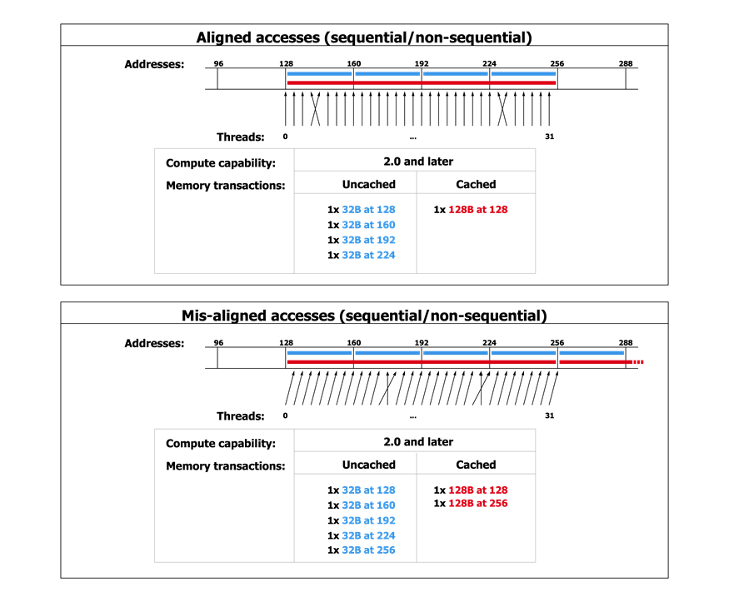
Scenario A: Coalesced and aligned – great!
[NVIDIA]$→$

Slide 13
Scenario B: Coalesced, but not aligned
[NVIDIA]$→$

Slide 14
Why is this important?
In Scenario B you have half the effective bandwidth you get in Scenario A
Just because of the alignment of your data access
If your code is memory bound and dominated by this type of access, you might see a sizeable slow down…
The moral of the story:
When you reach out to fetch data from global memory, visualize how a full warp reaches out for access.
Is the access coalesced and well aligned?

Slide 15
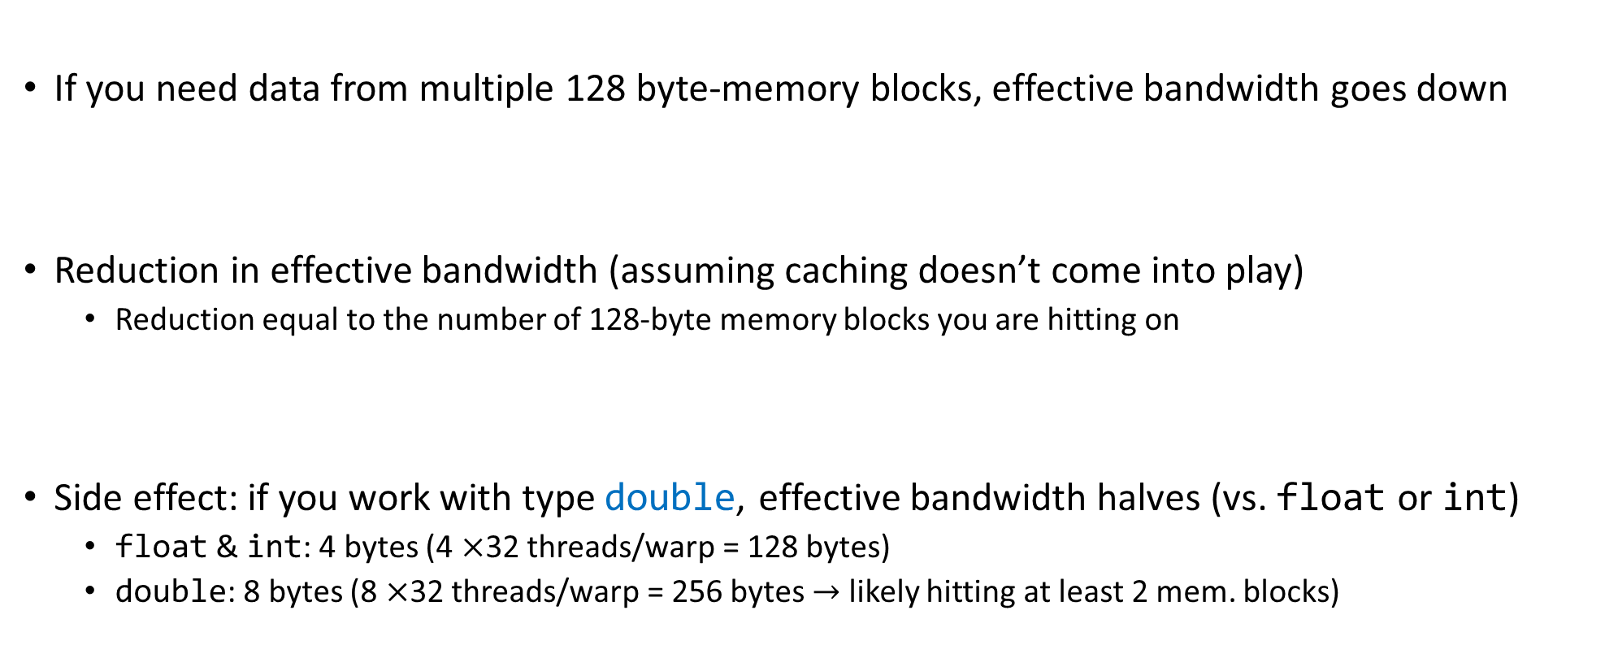
A note on the effective bandwidth
If you need data from multiple 128 byte-memory blocks, effective bandwidth goes down
Reduction in effective bandwidth (assuming caching doesn’t come into play)
Reduction equal to the number of 128-byte memory blocks you are hitting on
Side effect: if you work with type double, effective bandwidth halves (vs. float or int)
float & int: 4 bytes (4 $×$32 threads/warp = 128 bytes)
double: 8 bytes (8 $×$32 threads/warp = 256 bytes $→$ likely hitting at least 2 mem. blocks)

Slide 16
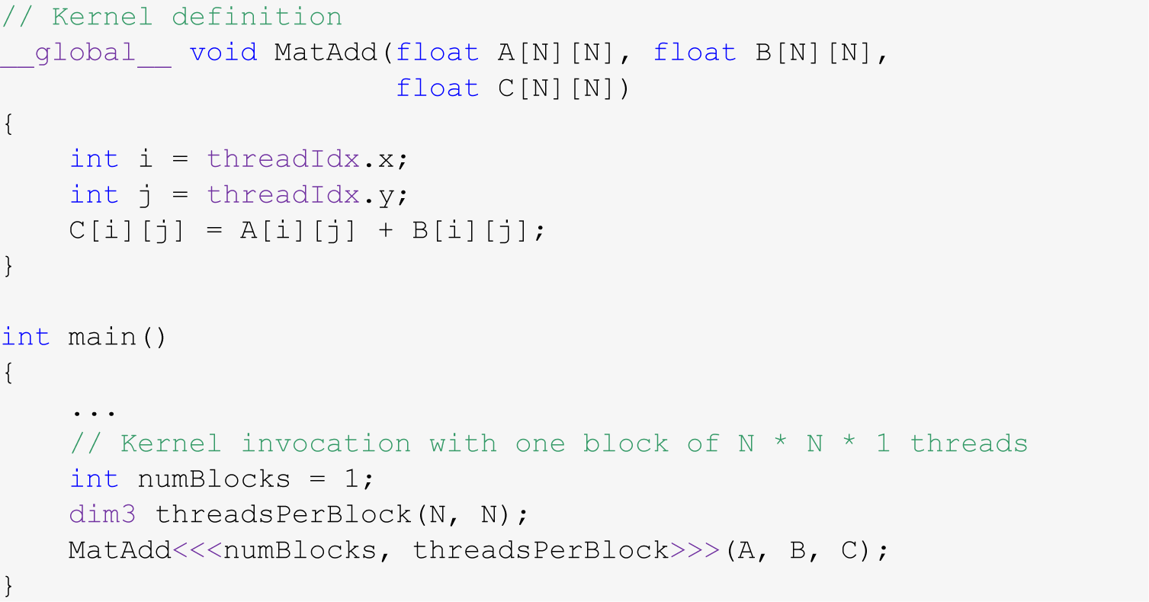
Example: Adding Two Matrices
You have two matrices A and B of dimension NxN (N=32)
You want to compute C=A+B in parallel
Code provided below (some details omitted, such as #define N 32)

Slide 17
Test Your Understanding
Given that the x field of a thread index changes the fastest, is the array indexing scheme on the previous slide good or bad?
HINT: think how threads are mapped into a set of 1D sequence of consecutive IDs
The “good or bad” refers to how data is accessed in the device’s global memory
In other words should we have
or…
C[i][j] = A[i][j] + B[i][j]
C[j][i] = A[j][i] + B[j][i]
Notes:
Mapping threads to data is not unique. Some choices are better than others… (from a memory access point of view)
Must keep in mind how 2-dimensional arrays are stored in C/C++
Answer: C[j][i] = A[j][i] + B[j][i]

Slide 18
Reflecting on Accessing Global Memory in CUDA
Assume dA is a device array, holding ints
Assume z[] is an array of unsigned ints
Which of these global memory accesses are good/bad? Why?
dA[threadIdx.x]
dA[threadIdx.x+2]
dA[3*threadIdx.x+2]
dA[z[threadIdx.x]]
This might be helpful: When answering 1-4 above, imagine you’re a thread and try to understand what the other 31 threads in the warp do when the warp executes some memory instruction
Notes:
Some of these scenarios can lead to out-of-bounds access as well. Particularly the last one

Slide 19
How Do You Avoid Bad Memory Accesses?
Design your data structures in a way that leads to advantageous memory accesses
Choosing a design: done before you write any line of code
Reflect on your algorithm
What data it needs, how much of it, where you read from/write to, how often
A good data structure design for parallel computing is likely different than a good data structure design for sequential computing
I learn programming exclusively thinking about correctness
Other aspects to consider when writing code:
speed of execution & convenience & productivity & code legacy & large team development & portability

Slide 20
Related to Data Organization
Say you use in your program complex data constructs that could be organized using C-structures
For GPU computing, how is it more advantageous to store data in global memory?
Alternative A: as an array of structures (AoS)
Alternative B: as a structure of arrays (SoA)
If you use all the data in a struct once you bring over, question not that relevant (although there are aspects that come into play)
However, if you only use one field from a struct, stick w/ SoA
Notes:
Example: 3D points
AoS: Swiss cheese (many holes → wasted trips to memory)
SoA: Parmesan (very dense)

Slide 21
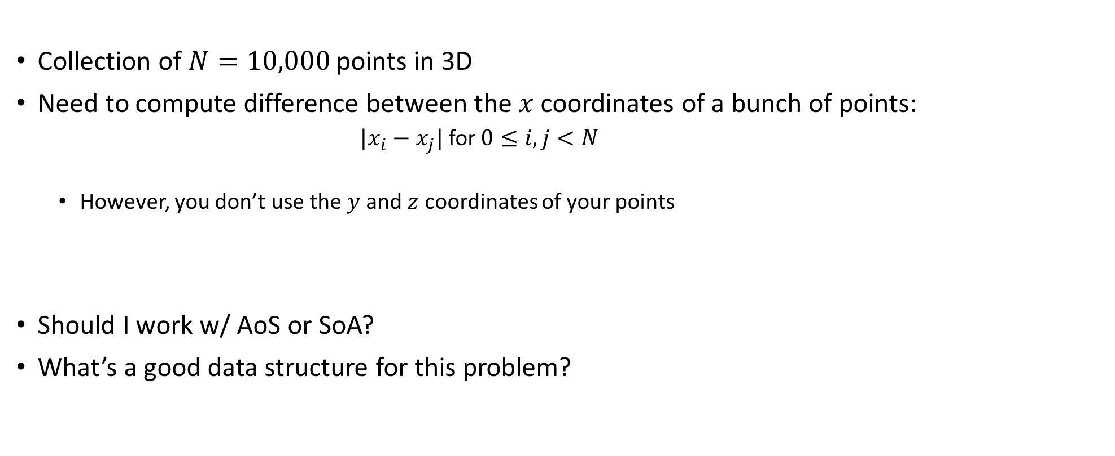
SoA or AoS?
Collection of $N=10,000$ points in 3D
Need to compute difference between the $x$ coordinates of a bunch of points:
${|x}_{i}−x_{j}|$ for $0≤i,j<N$
However, you don’t use the $y$ and $z$ coordinates of your points
Should I work w/ AoS or SoA?
What’s a good data structure for this problem?

Slide 22
Latency vs. Bandwidth, or how the CPU and GPU go about hiding memory access overhead
CPU uses the low latency of the cache to hide memory access overhead
Caches have small latency; bandwidth though is that of the system memory
Why? Caches are small, 256 KB, doesn’t make sense to talk about bandwidth when all you have is 0.000256 GB
GPU hides memory latency by using a combination of two things: SM oversubscription & high bandwidths
Caveat: data needs to find its way into the GPU global memory
PCIe – a good I/O bus, but not a good memory bus
NVLINK: a good memory bus

Slide 23
Atomic Operations

Slide 24
Coordinating Memory Operations to Avoid Data Hazards
Accesses to shared locations (global memory & shared memory) need to be correctly choreographed (orchestrated) to avoid race conditions
In many common shared memory multithreaded programming models, one uses coordination mechanisms such as locks to choreograph accesses to shared data
CUDA has a scalable coordination mechanism called “atomic memory operation”

Slide 25
Before diving in
Next slides: several examples that show “race conditions”

Slide 26
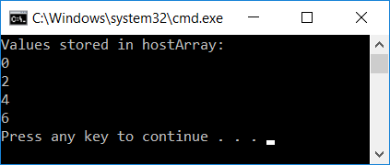
Recall a CUDA Early Example
#include<cuda.h>
#include<iostream>
__global__ void simpleKernel(int* data)
{
//this adds a value to a variable stored in global memory
data[threadIdx.x] = data[threadIdx.x] + 2*(blockIdx.x + threadIdx.x);
}
int main() {
const int numElems = 4;
int hostArray[numElems], *devArray;
//allocate memory on the device (GPU); zero out all entries in this device array
cudaMalloc((void**)&devArray, sizeof(int) * numElems);
cudaMemset(devArray, 0, numElems * sizeof(int));
//invoke GPU kernel, with one block that has four threads
simpleKernel<<<1,4>>>(devArray);
//bring the result back from the GPU into the hostArray
cudaMemcpy(&hostArray, devArray, sizeof(int) * numElems, cudaMemcpyDeviceToHost);
//print out the result to confirm that things are looking good
std::cout << "Values stored in hostArray: " << std::endl;
for (int i = 0; i < numElems; i++)
std::cout << hostArray[i] << std::endl;
//release the memory allocated on the GPU
cudaFree(devArray);
return 0;
}
Notes:
Let’s jump right into a non-trivial CUDA example.
Shows the main elements of CUDA programming (80/20 rule)
Explain:
__global__
cudaMalloc
kernel execution configuration
cudaMemcpy
nvcc looks for such keywords and separates code that is supposed to run on CPU and GPU

Slide 27
Old Question…
In our code, we invoked the kernel like this:
simpleKernel<<<1,4>>>(devArray)
What would happen if we invoke the kernel like this:
simpleKernel<<<2,4>>>(devArray)

Slide 28
Another Race Condition
A contrived (cooked up) example…
// update.cu
__global__ void update_race(int* x, int* y)
{
int i = threadIdx.x;
if (i < 2)
*x += *y;
else
*x += 2*i;
}
// main.cpp
update_race<<<1,4>>>(d_x, d_y);
cudaMemcpy(y, d_y, sizeof(int), cudaMemcpyDeviceToHost);

Slide 29
Example: Inter-Block Issue
Would this fly?
// update.cu
__global__ void updateVals(int* x)
{
int i = threadIdx.x;
if (i == 0) *x += blockIdx.x;
}
// main.cpp
// assume d_x starting value is zero
updateVals<<<2,5>>>(d_x);

Slide 30
Atomics, Introduction
Atomic memory operations (atomic functions) are used to solve access coordination problems in parallel computing
General concept: provide a mechanism for a thread to update a memory location such that the update appears to happen without interruption (atomically) with respect to all other threads
This ensures that all atomic updates issued are performed (in some unspecified order) to completion and that all threads can observe all updates

Slide 31
Atomic Functions, Example [1/3]
Atomic functions perform read-modify-write operations on data residing in global or shared memory
//example of int atomicAdd(int* addr, int val)
__global__ void update(unsigned int* x)
{
int i = threadIdx.x + blockDim.x * blockIdx.x;
int j = atomicAdd(x, i); // j is now old value of x;
}
//-----------------------------------
// snippet of code in main.cu; mem. was already allocated on device
int x = 0;
cudaMemcpy(&d_x, &x, cudaMemcpyHostToDevice);
update<<<1,128>>>(&d_x);
cudaMemcpy(&x, &d_x, cudaMemcpyDeviceToHost);
NVIDIA [J. Balfour]→
Side-note question: in example below, are we working w/ global or shared memory?
Notes:
[DN]
This is what used to be: int j = atomicAdd(x, 1); // j = *x; *x = j + i;
This is now: int j = atomicAdd(x, 1); // j = *x;

Slide 32
Atomic Functions [2/3]
Atomic functions perform read-modify-write operations on data that can reside in global or shared memory
Synopsis of atomic function atomicOP(a,b) is typically
t1 = *a; // read
t2 = (*a) OP (*b); // modify
*a = t2; // write
return t1;
All statements are executed atomically without interruption by any other function/process
The atomic function returns the initial value, *not* the final value, stored at the memory location
NVIDIA [J. Balfour]→

Slide 33
Atomic Functions [3/3]
The order in which concurrent atomic updates are performed is not defined, and may appear arbitrary
While order is not clear, none of the atomic updates will be lost
Several different kinds of atomic operations:
Add (add), Sub (subtract), Inc (increment), Dec (decrement)
And (bit-wise and), Or (bit-wise or) , Xor (bit-wise exclusive or)
Exch (Exchange)
Min (Minimum), Max (Maximum)
Compare-and-Swap
Etc.
NVIDIA [J. Balfour]→

Slide 34
Histogram Example
// Compute histogram of colors in an image
//
// picturePixels – pointer to picture pixels, each w/ its own color
// picturePixels[i] – takes a value between 0 and 6 (7 colors total)
// bucket–pointer to histogram bucket of size equal to # of colors
//
__global__ void histogram(int n, int* picturePixels, int* bucket)
{
int i = threadIdx.x + blockDim.x * blockIdx.x;
if (i < n)
{
int c = picturePixels[i];
atomicAdd(&bucket[c], 1);
}
}
NVIDIA [J. Balfour]→
Notes:
picturePixels[i] returns one of say seven integers that correspond to the possible seven colors in the picture.
“bucket” is an array of int of dimension seve.

Slide 35
Performance Notes
While very convenient to use, atomics do impact the speed of the code
Performance poor when many threads attempt to perform atomic operations on a small number of locations
Bad case: all threads trying to update the same variable
NVIDIA [J. Balfour]→
Notes:
Hammad: The kepler and Maxwell architectures improved atomic performance. Maxwell improved performance for shared memory atomics.

Slide 36
No mix-and-match, please…
Atomic updates are not guaranteed to appear atomic to concurrent accesses that also use loads and stores
No mix and match, please
__global__ void broken(int n, int* x)
{
int i = threadIdx.x + blockDim.x * blockIdx.x;
if (i == 0)
{
*x = *x + 1;
}
else
{
int j = atomicAdd(x, 1); // j = *x; *x += i;
}
}
// main.cpp
broken<<<1,128>>>(128, d_x); // d_x = d_x + {1, 127, 128}
NVIDIA [J. Balfour]→

Slide 37
Rules of thumb, atomic ops
When to use: Cannot fall back on normal memory operations because of possible race conditions
Use for infrequent, sparse, and/or unpredictable global communication
Use shared memory and/or customized data structures & algorithms to avoid synchronization whenever reasonable
Recent compute capabilities (post Maxwell) improved the speed of atomic operations
NVIDIA [J. Balfour]→

Slide 38
Synchronization vs. Coordination
There is a qualitative difference between a __syncthreads() function and an atomic operation
__syncthreads() has the connotation of barrier; i.e., of synchronization
__syncthreads() establishes a point in the execution of the kernel that every thread in the **block** needs to reach before any block thread can move beyond that point. Also, all memory ops are seen through
The “atomic operation” concept instead tied to the idea of coordination in relation to operations that involve memory transactions
Threads need not synchronize their execution, it’s only that a certain memory operation in a kernel is conducted in an atomic fashion

Slide 39
Resource Management Considerations

Slide 40
What is “Resource Management”?
The GPU is a resourceful device
How do you get to use the card at capacity?
“used at capacity”: SM executes the max. number of warps it can possibly host
The three factors that come into play are
How many threads you decide to use in each block - threads/block = ?
What register requirements end up associated with a thread - registers/thread = ?
How much shared memory you assign to one block of threads - shMem/block = ?

Slide 41
Some Hard Constraints (1/2)
Max number of warps that one SM can service simultaneously:
32 on Tesla C1060 and Turing (wow)
48 on Fermi
64 on Kepler, Maxwell, Pascal, and Volta
Max number of blocks that one SM can process simultaneously:
8 on Fermi
16 on Kepler and Turing (wow)
32 on Maxwell, Pascal, and Volta
Notes:
Fermi: must have at least 2 blocks to even have a chance to reach 100% occupancy
Indeed, 1024 max. threads/ block → 32 max. warps / block

Slide 42
Some Hard Constraints (2/2)
The number of 32-bit registers available on each SM is limited:
16,384 registers (on Tesla C1060)
Roughly 48,000 on Fermi
Roughly 64,000 on Kepler, Maxwell, Pascal, and Volta
The amount of shared memory available to each SM is limited
16 KB on Tesla 1060
64 KB on Fermi (16/48 or 48/16 configurable between L1 and shared memory)
64 KB on Kepler (16/48 or 48/16 or 32/32 configurable)
64 KB on Maxwell and Pascal, but not split w/ L1
96 KB on Volta (this is split-able again, w/ L1 and texture)
Note: there is also a max amount of ShMem that a block can get assigned
At 48 KB , sometimes 64KB, sometimes 96 KB
Notes:
Also, each thread can use a maximum of 256 registers

Slide 43
The Concept of Occupancy (1/2)
Let’s talk Pascal on this slide (discussion similar for Volta, Maxwell, Kepler, etc.)
On Pascal, you want to have up to 64 warps serviced at the same time by one SM (that is, 64 warps in flight)
High warp count: increases likelihood of hiding mem access latencies with useful computation
Occupancy examples:
Four blocks with 512 threads running together on one SM: 100% occupancy
Four blocks of 256 threads each running on one SM: 50% occupancy
96 blocks with 32 threads each – oops, can’t have more than 32 blocks on a Volta SM
Effectively this scenario gives you at most 50% occupancy (up to 32 blocks w/ 32 threads each)
Notes:
maximum 48 resident warps/SM - Fermi

Slide 44
The Concept of Occupancy (2/2)
registers | ↔ | per thread
shared mem | ↔ | per block
What prevents you from getting high occupancy?
Amount of shared mem demanded by each block
Total amount of shared memory in one SM is limited: up to 64 Kb on Pascal
Number of registers used by each thread
Size of the register file in one SM: 64K four byte registers on Kepler, Maxwell, Pascal, etc.
How do you find out how many registers and shared memory get used?
Solution 1: using the CUDA profiler
Solution 2: use the flag –ptax-options=-v when you compile your kernel w/ nvcc

Slide 45
Examples, Occupancy of hardware (Fermi example, 48 KB of ShMem)
Example 1, Fermi: If each of your block demands 80 KB of shared memory, the kernel will fail to launch
Not enough memory on the SM to run even a block
Example 2, Fermi: If your blocks each uses 15 KB of shared mem, you can have up to three blocks running on one SM (there will be some shared mem that will go unused)
Example 3, Fermi: Like Example 2 above, and you have 512 threads per block, each thread uses 30 registers. Will one SM be able to handle 2 blocks?
Total number of registers: 512 x 2 x 30 = 30,720 out of the 48,000 are used OK
Amount of shared memory: 2 x 15K = 30 KB, well below 48 KB OK
Number of warps: 2 blocks x 512 threads = 1024 threads = 32 warps < max of 48 OK
Quiz: Will the SM be able to handle 3 blocks?
Notes:
Yes, under these conditions, 3 blocks will still fit on an SM.
Moreover, we would get 100% occupancy (512 x 3 threads = 48 warps)
Attention: increasing the required number of registers per thread by only 1 or 2 can immediately drop occupancy (by limiting the number of blocks that can be assigned to one SM)
Indeed, in example 3, if each thread requires 32 registers, we can only fit 2 blocks/SM! → 66% drop in occupancy

Slide 46
NVIDIA CUDA Occupancy Calculator
There is an “occupancy calculator” that can tell you what percentage of the HW gets utilized by your kernel
Comes as an Excel spreadsheet
Requires the following input
Compute capability
Threads per block
Registers per thread
Shared memory per block
Selected Shared Memory Size Config (bytes)
Selected Global Load Caching Mode
Search online “CUDA occupancy calculator” to get the excel file
Notes:
Can also use compiler flags to report resource utilization.
For example, passing –ptax-options=-v to nvcc will report the number of registers/thread
Profiler will also give you all this information.

Slide 47
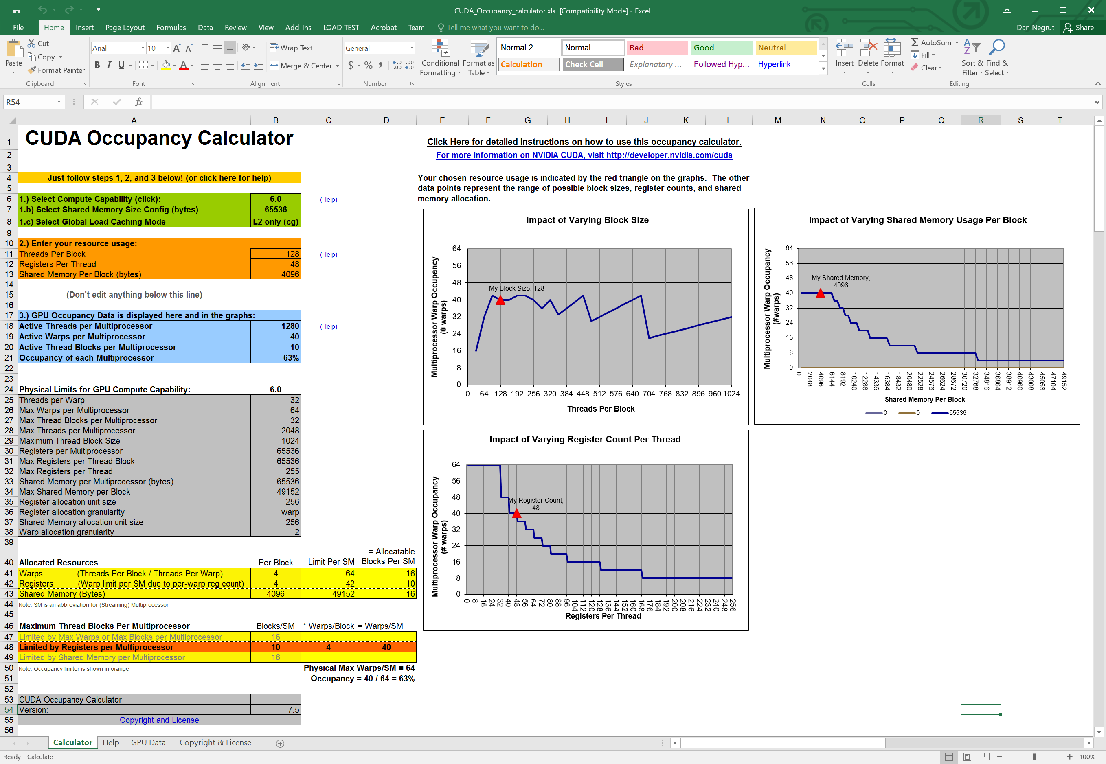
NVIDIA CUDA Occupancy Calculator
Google this term: “cuda occupancy calculator”

Slide 48
Example: Occupancy Study [NOTE: Specific to Fermi]
For Matrix Multiplication example (with shared memory), should I use 8x8, 16x16, or 64x64 threads per blocks?
For 8x8, we have 64 threads per Block. Since each Fermi SM can manage up to 1536 resident threads, it could take up to 32 Blocks. However, each SM is limited to 8 resident Blocks, so only 512 threads will go into each SM!
For 16x16, we have 256 threads per Block. Since each Fermi SM can take up to 1536 resident threads, it can take up to 6 Blocks unless other resource considerations overrule.
Next you need to see how much shared memory and how many registers get used in order to understand whether you can actually have four blocks per SM
64x64 is a no starter, you can only have up to 1024 threads in a block, the tile cannot be this big

Slide 49
Occupancy != Performance [yet a pretty good proxy]
Increasing occupancy does not necessarily increase performance
If you want to read more about this, there is a Volkov paper, assigned reading
What controls the damage is the Instruction Level Parallelism (ILP) that the compiler can capitalize on (better efficiency in pipelining, instruction reordering, etc.)
HOWEVER,
Low-occupancy multiprocessors are likely to have a hard time when it comes to hiding latency on memory-bound kernels
This latency hiding draws on Thread Level Parallelism (TLP); i.e., having enough threads (warps, that is) that are ready for execution

Slide 50
Parameterize Your Application
Parameterization helps adaptation to different GPUs
GPUs vary in many ways
# of SMs
Memory bandwidth
Shared memory size
Register file size
Max. threads per block
Max. number of warps per SM
You can even make apps self-tuning (like FFTW and ATLAS)
“Experiment” mode discovers and saves optimal configuration

Slide 51
CUDA Optimization Rules of Thumb

Slide 52
Writing CUDA Software: High-Priority Recommendations
To get the maximum benefit from CUDA, focus first on finding ways to parallelize sequential code. Expose fine grain parallelism
Minimize data transfer between the host and the device, even if it means running some kernels on the device that do not show performance gains when compared with running them on the host CPU
Very good resource: http://docs.nvidia.com/cuda/cuda-c-best-practices-guide/index.html#abstract

Slide 53
Writing CUDA Software: High-Priority Recommendations
Strive to have aligned and coalesced global memory accesses. Design your implementation such that global memory accesses are coalesced for that part of the red-hot parts of the code
Minimize the use of global memory. Prefer shared memory access where possible (consider tiling as a design solution)
http://docs.nvidia.com/cuda/cuda-c-best-practices-guide/index.html#abstract

Slide 54
Writing CUDA Software: Medium-Priority Recommendations
Accesses to shared memory should be designed to avoid serializing requests due to bank conflicts
Maintain sufficient numbers of active threads per multiprocessor (i.e., sufficient occupancy)
Keep the number of threads per block a multiple of 32 to avoid wasted lanes
http://docs.nvidia.com/cuda/cuda-c-best-practices-guide/index.html#abstract

Slide 55
Writing CUDA Software: Medium-Priority Recommendations
Use the fast math library whenever speed is very important and you can live with a tiny loss of accuracy
Avoid thread divergence
http://docs.nvidia.com/cuda/cuda-c-best-practices-guide/index.html#abstract
Notes:
There used to be a sixth bullet above: 6. Use signed integers rather than unsigned integers as loop counters
The compiler can optimize more aggressively with signed arithmetic than it can with unsigned arithmetic (due to rules regarding overflow behavior). This is of particular note with loop counters
In the C language standard, unsigned integer overflow semantics are well defined, whereas signed integer overflow causes undefined results. Therefore, the compiler can optimize more aggressively with signed arithmetic than it can with unsigned arithmetic. This is of particular note with loop counters: since it is common for loop counters to have values that are always positive, it may be tempting to declare the counters as unsigned. For slightly better performance, however, they should instead be declared as signed.

Slide 56
Some nuts and bolts, compiler related and such

Slide 57
Compiling CUDA Code [with nvcc driver]
C/C++ CUDA
Application
NVCC
CPU Code
PTX Code
PTX to Target
Compile
K20X
…
P100
Target binary cubin code
Notes:
nvcc separates what should run on CPU from GPU code
First stage is to translate into PTX code (assembly)
PTX is machine independent
FORTRAN generates PTX too
Second stage: compile PTX for target GPU

Slide 58
PTX: Parallel Thread eXecution
PTX: an assembly language used in CUDA programming environment
nvcc translates code written in CUDA’s C into the language-agnostic Intermediate Representation, and then into PTX assembly
nvcc subsequently invokes an assembler which translates the PTX into a binary code which can be run on a certain GPU
PTX for fillKernel
.entry _Z10fillKernelPii (
.param .u64 __cudaparm__Z10fillKernelPii_a,
.param .s32 __cudaparm__Z10fillKernelPii_n)
{
.reg .u16 %rh<4>;
.reg .u32 %r<6>;
.reg .u64 %rd<6>;
.reg .pred %p<3>;
.loc 14 5 0
$LDWbegin__Z10fillKernelPii:
mov.u16 %rh1, %ctaid.x;
mov.u16 %rh2, %ntid.x;
mul.wide.u16 %r1, %rh1, %rh2;
cvt.u32.u16 %r2, %tid.x;
add.u32 %r3, %r2, %r1;
ld.param.s32 %r4, [__cudaparm__Z10fillKernelPii_n];
setp.le.s32 %p1, %r4, %r3;
@%p1 bra $Lt_0_1026;
.loc 14 9 0
ld.param.u64 %rd1, [__cudaparm__Z10fillKernelPii_a];
cvt.s64.s32 %rd2, %r3;
mul.wide.s32 %rd3, %r3, 4;
add.u64 %rd4, %rd1, %rd3;
st.global.s32 [%rd4+0], %r3;
$Lt_0_1026:
.loc 14 11 0
exit;
$LDWend__Z10fillKernelPii:
}
__global__ void fillKernel(int *a, int n)
{
int tid = blockIdx.x*blockDim.x + threadIdx.x;
if (tid < n) {
a[tid] = tid;
}
}
Notes:
PTX
similar to assembly code
does not contain information on what particular GPU card the code should run (device neutral representation)
important to distribute CUDA code to clients without knowing their GPU capability
[Colin] PTX is an assembly language. There is a separate assembler called ptxas which is used to build it.
nvcc is an LLVM-based compiler (like Clang); It generates a subset of LLVM IR called NVVM IR, which is then compiled to PTX assembly.
Other CUDA compilers (Fortran, for example) generate this IR, and then the rest of the process acts as normal.

Slide 59
More on the nvcc compiler
File suffix | How the nvcc compiler interprets the file
.cu | CUDA source file, containing host and device code
.cuh | CUDA header files, containing host and device code
.cup | Preprocessed CUDA source file, containing host code and device functions
.c | C source file
.cc, .cxx, .cpp | C++ source file
.gpu | GPU intermediate file (device code only)
.ptx | PTX intermediate assembly file (device code only)
.cubin | CUDA device only binary file
Notes:
nvcc can output
C code (which must then be compiled with the rest using another tool)
ptx code (device independent)
object code (cubin)

Slide 60
The JIT story
C code gets converted into an Intermediate Representation (IR) called NVVM IR
NVVM IR is then converted to PTX assembly
PTX assembly gets assembled into binary code for some number of GPU targets (“cubin”)
Why the intermediate steps?
Brings into the picture the concept of just-in-time (JIT) compiling
Compilers for other languages can generate this intermediate representation rather than implementing a dialect of PTX assembly for each frontend language (Clang and CUDA Fortran do this)
PTX material can be converted at run-time into cubin instructions
Why bother with JIT?
CON: JIT increases the load-time of an application (since an additional compile step needs to happen)
PRO: Allows the app to benefit from newer devices (better compilers, more advanced features supported by the hardware)
The only way an app can run on a device that didn’t exist at the time the PTX was generated
Notes:
[Colin] PTX is an assembly language. There is a separate assembler called ptxas which is used to build it.
nvcc is an LLVM-based compiler (like Clang); It generates a subset of LLVM IR called NVVM IR, which is then compiled to PTX assembly.
Other CUDA compilers (Fortran, for example) generate this IR, and then the rest of the process acts as normal.

Slide 61
JIT and the magic of –code and –arch nvcc flags
How does one control how PTX is generated?
How does one control how the cubin is generated?

Slide 62
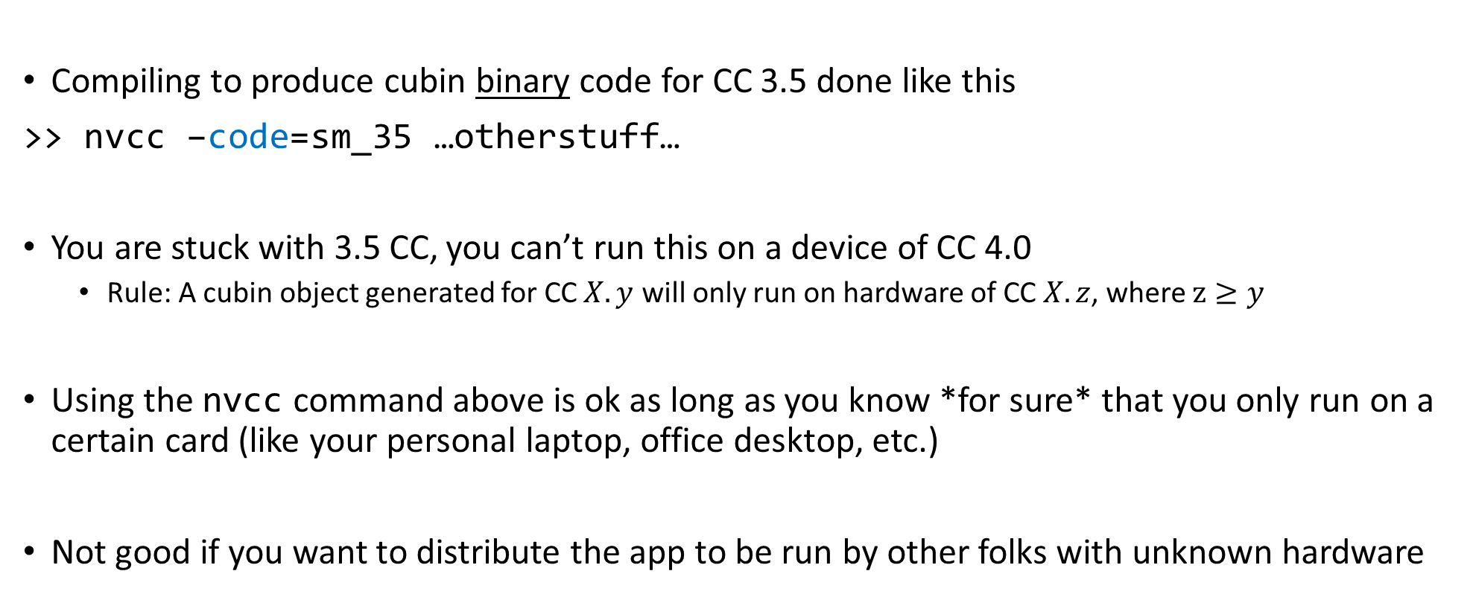
Getting stuck with a CC, via the –code flag
Compiling to produce cubin binary code for CC 3.5 done like this
>> nvcc –code=sm_35 …otherstuff…
You are stuck with 3.5 CC, you can’t run this on a device of CC 4.0
Rule: A cubin object generated for CC $X.y$ will only run on hardware of CC $X.z$, where $z≥y$
Using the nvcc command above is ok as long as you know *for sure* that you only run on a certain card (like your personal laptop, office desktop, etc.)
Not good if you want to distribute the app to be run by other folks with unknown hardware

Slide 63
A word on PTX compatibility, and the role of the –arch flag
Some CUDA features supported only on devices of higher CC
Example: unified (managed) memory
You can control the C to PTX translation so that you do/don’t pick certain CUDA features
Example: Warp Shuffle Function available only in CC 3.0 and above
Code that contains Warp Shuffle functionality should be compiled with this in mind
Accomplished by the use of the –arch=compute_30 flag on nvcc
>> nvcc –arch=compute_30 …blahblah…
NOTE: the PTX generated by the above can then be compiled to cubin to run on higher CC
Recall the cubin generation control by the –code flag

Slide 64
Example, combining –arch and –code via -gencode
>> nvcc x.cu
-gencode arch=compute_35,code=sm_35
-gencode arch=compute_50,code=sm_50
-gencode arch=compute_60,code=\'compute_60,sm_60\'
The cubin fat binary generated by this command embeds the following (it’s got bigger footprint to accommodate all):
Binary code generated to work on Kepler (CC 3.5)
Binary code generated to work on Maxwell (CC 5.0)
PTX and binary code to work on Pascal (CC 6.0)
The arch part says that the binary code in each case should be produced based on PTX code generated as you’d expect: binary for 3.5 comes from PTX for 3.5, binary for 5.0 comes from PTX for 5.0, binary for 6.0 comes from PTX for 6.0
Shortcut: you can get -gencode arch=compute_60,code=\'compute_60,sm_60\‘ by simply saying :
>> nvcc x.cu -arch=sm_60
If you don’t say anything but “nvcc x.cu” the compile driver will use default arch & code settings

Slide 65
CUDA Case Study: Parallel Reduction

Slide 66
Parallel Reduction in CUDA
Exercise draws on material made available by Mark Harris of NVIDIA
Parallel Reduction: Common and important data parallel primitive
Example: Used to compute the norm of a large vector
Easy to implement in CUDA
Challenging to get it to run fast though
Serves as a good optimization example
Walk step by step through several different versions
Demonstrates several important optimization strategies
Results are for old CC, yet it’s instructive to understand how far folks went to get top performance
NVIDIA [M. Harris]→

Slide 67
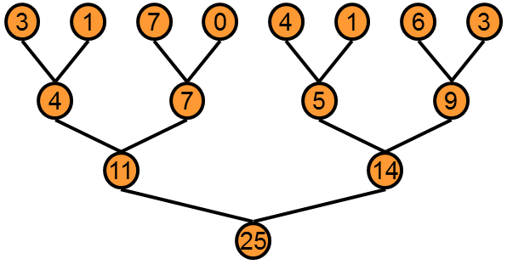
Parallel Reduction
Basic Idea: tree-based approach used within each thread block
Backdrop: assume you have very large arrays – 100,000 entries and beyond
Keep all multiprocessors on the GPU busy
Each thread block reduces a portion of the array to one single value
Q: How do we communicate partial results between thread blocks?
NVIDIA [M. Harris]→

Slide 68
Problem: Global Synchronization
If we could synchronize across all thread blocks, could easily reduce very large arrays
Global sync after each block produces its result
Once all blocks reach sync, continue recursively
But CUDA has no global synchronization
Only synchronization of threads that belong to the same block
Solution: decompose into multiple kernels
Kernel launch serves as a global synchronization point
Kernel launch has negligible overhead
NVIDIA [M. Harris]→

Slide 69
Multiple Kernel Calls [An Example, and how it all works out…]
Imagine you launch a 1D grid in which each 1D block has 256 threads
Assume that the number or elements in the array is N=100,000
Note that 100,000= 390*256 + 160, therefore [(N+255)/256]=391 blocks needed
For the first stage, you launch 391 blocks of 256 threads
At the end of this stage you still have to operate on 391 elements
For the second stage, you launch two blocks of 256 threads
At the end of this stage you only have to operate on two elements
For the third and last stage, you launch one block of 32 threads
Almost all threads idle…
NOTE: after the first stage, each subsequent stage operates on a number of entries equal to the number of blocks in the previous stage

Slide 70
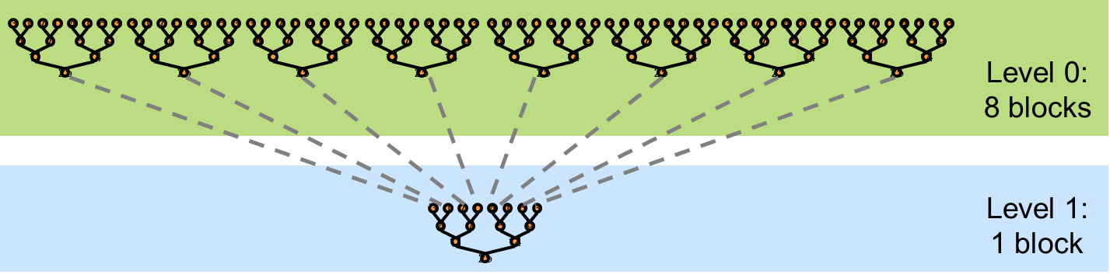
Vector Reduction: 30,000 Feet Perspective
At the block level: Bring data in shared memory, then start adding in parallel
Fewer and fewer threads of a block participate
The process is memory bound, low arithmetic intensity…
Data staged in shared memory
A small number of threads finishes off
NVIDIA [M. Harris]→

Slide 71
What is Our Optimization Goal?
We should strive to reach GPU peak performance
Choose the right metric:
GFLOP/s: for compute-bound kernels
Bandwidth: for memory-bound kernels
Reductions have very low arithmetic intensity
1 flop per element loaded (bandwidth-optimal)
Therefore we should strive for peak bandwidth
We’ll go through an old example - results generated using an old G80 GPU
Compute capability (CC) 1.0
384-bit memory interface, 900 MHz DDR
384 * 0.900 *2 / 8 = 86.4 GB/s
Example carries over to other CCs – on NVIDIA hardware this algorithm will always be memory bound
NVIDIA [M. Harris]→

Slide 72
Parallel Reduction: Interleaved Addressing
Values (shared memory)
10 | 1 | 8 | -1 | 0 | -2 | 3 | 5 | -2 | -3 | 2 | 7 | 0 | 11 | 0 | 2
Step 1 Stride 1
Thread IDs
0
2
4
6
8
10
12
14
Values
11 | 1 | 7 | -1 | -2 | -2 | 8 | 5 | -5 | -3 | 9 | 7 | 11 | 11 | 2 | 2
Step 2 Stride 2
Thread IDs
0
4
8
12
Values
18 | 1 | 7 | -1 | 6 | -2 | 8 | 5 | 4 | -3 | 9 | 7 | 13 | 11 | 2 | 2
Step 3 Stride 4
Thread IDs
0
8
Values
24 | 1 | 7 | -1 | 6 | -2 | 8 | 5 | 17 | -3 | 9 | 7 | 13 | 11 | 2 | 2
Step 4 Stride 8
Thread IDs
0
Values
41 | 1 | 7 | -1 | 6 | -2 | 8 | 5 | 17 | -3 | 9 | 7 | 13 | 11 | 2 | 2
Note: in stage s, only threads divisible to 2^s get to do work. Stride: 2^(s-1)
NVIDIA [M. Harris]→
Notes:
In stage s, only thread who’s divisible to 2^s gets to work

Slide 73
Reduction #1: Interleaved Addressing
__global__ void reduce1(int *g_idata, int *g_odata) {
extern __shared__ int sdata[];
// each thread loads one element from global to shared mem
unsigned int tid = threadIdx.x;
unsigned int i = blockIdx.x*blockDim.x + threadIdx.x;
sdata[tid] = g_idata[i];
__syncthreads();
// do reduction in shared mem
for(unsigned int s=1; s < blockDim.x; s *= 2) {
if (tid % (2*s) == 0) {
sdata[tid] += sdata[tid + s];
}
__syncthreads();
}
// write result for this block to global memory
if (tid == 0) g_odata[blockIdx.x] = sdata[0];
}
Why do we need
to sync threads?
First, threads w/ ID multiple of 2 do work
Next, threads w/ ID multiple of 4 do work
Next, threads w/ ID multiple of 8 do work
And so on…
Problem: highly divergent
warps are inefficient, and %
operator is very slow
NVIDIA [M. Harris]→
Notes:
DN: the number of elements after one stage = number of blocks that were launched to deal with that stage
First, threads multiple of 2 do work
Next, threads multiple of 4 do work
Next, threads multiple of 8 do work
And so on…

Slide 74
Performance for 4 Million element reduction
Time (2²² ints)
Bandwidth
Kernel 1: interleaved addressing with divergent branching | 8.054 ms | 2.083 GB/s
Note: Block Size = 128 threads for all tests
NVIDIA [M. Harris]→

Slide 75
Parallel Reduction: Interleaved Addressing
Values (shared memory)
10 | 1 | 8 | -1 | 0 | -2 | 3 | 5 | -2 | -3 | 2 | 7 | 0 | 11 | 0 | 2
Step 1 Stride 2⁰
Thread IDs
0
1
2
3
4
5
6
7
Values
11 | 1 | 7 | -1 | -2 | -2 | 8 | 5 | -5 | -3 | 9 | 7 | 11 | 11 | 2 | 2
Step 2 Stride 2¹
Thread IDs
0
1
2
3
Values
18 | 1 | 7 | -1 | 6 | -2 | 8 | 5 | 4 | -3 | 9 | 7 | 13 | 11 | 2 | 2
Step 3 Stride 2²
Thread IDs
0
1
Values
24 | 1 | 7 | -1 | 6 | -2 | 8 | 5 | 17 | -3 | 9 | 7 | 13 | 11 | 2 | 2
Step 4 Stride 2³
Thread IDs
0
Values
41 | 1 | 7 | -1 | 6 | -2 | 8 | 5 | 17 | -3 | 9 | 7 | 13 | 11 | 2 | 2
New Problem: Shared Memory Bank Conflicts
NVIDIA [M. Harris]→

Slide 76
Reduction #2: Interleaved Addressing
Just replace divergent branch in inner loop…
for (unsigned int s=1; s < blockDim.x; s *= 2) {
if (tid % (2*s) == 0) {
sdata[tid] += sdata[tid + s];
}
__syncthreads();
}
Previous case: one thread works, several next to it don’t.
This case: thread A works & A+1 works too, except that A+1 goes far from the memory location where thread A goes
…with strided index and non-divergent branch:
for (unsigned int s=1; s < blockDim.x; s *= 2) {
int index = 2 * s * tid;
if (index < blockDim.x) {
sdata[index] += sdata[index + s];
}
__syncthreads();
}
NVIDIA [M. Harris]→
Notes:
First case: one thread works, several next to it don’t.
Second case: thread A works and A+1 works too, except that it goes far from the memory location where thread A goes

Slide 77
Performance for 4M element reduction
Step Speedup
Cumulative Speedup
Time (2²² ints)
Bandwidth
Kernel 1: interleaved addressing with divergent branching | 8.054 ms | 2.083 GB/s
Kernel 2: interleaved addressing with bank conflicts | 3.456 ms | 4.854 GB/s | 2.33x | 2.33x
NVIDIA [M. Harris]→

Slide 78
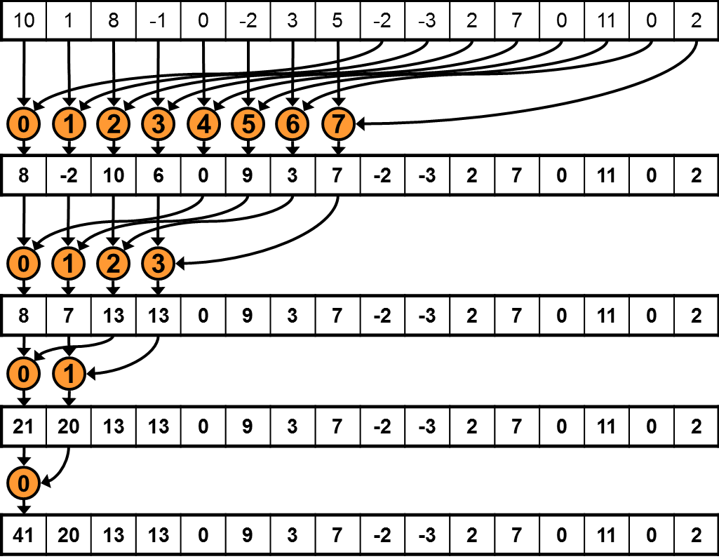
Parallel Reduction: Sequential Addressing
Values (shared memory)
Step 1 Stride 8
Thread IDs
Values
Step 2 Stride 4
Thread IDs
Values
Step 3 Stride 2
Thread IDs
Values
Step 4 Stride 1
Thread IDs
Values
Sequential addressing is Shared Mem. conflict free
NVIDIA [M. Harris]→

Slide 79
Reduction #3: Sequential Addressing
Just replace strided indexing in inner loop…
for (unsigned int s=1; s < blockDim.x; s *= 2) {
int index = 2 * s * tid;
if (index < blockDim.x) {
sdata[index] += sdata[index + s];
}
__syncthreads();
}
…with reversed loop and threadID-based indexing:
for (unsigned int s=blockDim.x/2; s>0; s>>=1) {
if (tid < s) {
sdata[tid] += sdata[tid + s];
}
__syncthreads();
}
First you go out 1/2 the block size to match a thread with its second operand
Then you go out 1/4 of the block size
Then you go out 1/8 of the block size
Etc.
NVIDIA [M. Harris]→
Notes:
DN:
- First you go half the size of the block to match a thread with its second operand
- Then you go ¼ of the block size
- Then you go 1/8 of the block size, etc.

Slide 80
Performance for 4M element reduction
Step Speedup
Cumulative Speedup
Time (2²² ints)
Bandwidth
Kernel 1: interleaved addressing with divergent branching | 8.054 ms | 2.083 GB/s
Kernel 2: interleaved addressing with bank conflicts | 3.456 ms | 4.854 GB/s | 2.33x | 2.33x
Kernel 3: sequential addressing | 1.722 ms | 9.741 GB/s | 2.01x | 4.68x
NVIDIA [M. Harris]→

Slide 81
Idle Threads…
Current solution:
for (unsigned int s=blockDim.x/2; s>0; s>>=1) {
if (tid < s) {
sdata[tid] += sdata[tid + s];
}
__syncthreads();
}
Half of the threads are idle on first loop iteration. This is wasteful…
NVIDIA [M. Harris]→

Slide 82
Reduction #4: First Add During Load
Replace single load:
// each thread loads one element from global to shared mem
unsigned int tid = threadIdx.x;
unsigned int i = blockIdx.x*blockDim.x + threadIdx.x;
sdata[tid] = g_idata[i];
__syncthreads();
…With two loads and first add of the reduction:
// perform first level of reduction upon reading from
// global memory and writing to shared memory
unsigned int tid = threadIdx.x;
unsigned int i = blockIdx.x*(blockDim.x*2) + threadIdx.x;
sdata[tid] = g_idata[i] + g_idata[i+blockDim.x];
__syncthreads();
Side-effect: number of blocks needed half of what it used to be…
NVIDIA [M. Harris]→
Notes:
DN: Instead of fetching one number, each thread now fetches two numbers. Therefore, the number of blocks is ½ of what used to be.
DN: A thread T brings from some position and also what used to be one block away. That’s why you have the “blockDim.x*2” in the computation of i

Slide 83
Performance for 4M element reduction
Step Speedup
Cumulative Speedup
Time (2²² ints)
Bandwidth
Kernel 1: interleaved addressing with divergent branching | 8.054 ms | 2.083 GB/s
Kernel 2: interleaved addressing with bank conflicts | 3.456 ms | 4.854 GB/s | 2.33x | 2.33x
Kernel 3: sequential addressing | 1.722 ms | 9.741 GB/s | 2.01x | 4.68x
Kernel 4: first add during global load | 0.965 ms | 17.377 GB/s | 1.78x | 8.34x
NVIDIA [M. Harris]→

Slide 84
Instruction Bottleneck
At 17 GB/s, we’re far from bandwidth bound
Therefore a likely bottleneck is instruction overhead
Ancillary instructions that are not loads, stores, or core arithmetic
In other words: address arithmetic and loop overhead
Strategy: unroll loops
NVIDIA [M. Harris]→

Slide 85
Unrolling the Last Warp
As reduction proceeds, the number of “active” threads decreases
When s <= 32, we have only one warp left
Instructions executed in lockstep fashion within a warp (not on Volta, though!)
That means when s <= 32:
We don’t need to __syncthreads()
We don’t need “if (tid < s)” because it doesn’t save any work
The key idea: unroll the last 6 iterations of the inner loop, which involve 32 or less threads
NVIDIA [M. Harris]→

Slide 86
Reduction #5: Unroll the Last Warp
// and use later like this…
for (unsigned int s=blockDim.x/2; s>32; s>>=1) {
if (tid < s)
sdata[tid] += sdata[tid + s];
__syncthreads();
}
if (tid < 32) warpReduce(sdata, tid);
This used to be:
S>0
__device__ void warpReduce(volatile int* sdata, int tid) {
sdata[tid] += sdata[tid + 32];
sdata[tid] += sdata[tid + 16];
sdata[tid] += sdata[tid + 8];
sdata[tid] += sdata[tid + 4];
sdata[tid] += sdata[tid + 2];
sdata[tid] += sdata[tid + 1];
}
IMPORTANT: For this to be correct, we must use the “volatile” keyword!
Note: This saves useless work in all warps, not just the last one!
Without unrolling, all warps execute every iteration of the for loop and if statement
NVIDIA [M. Harris]→

Slide 87
Performance for 4M element reduction
Step Speedup
Cumulative Speedup
Time (2²² ints)
Bandwidth
Kernel 1: interleaved addressing with divergent branching | 8.054 ms | 2.083 GB/s
Kernel 2: interleaved addressing with bank conflicts | 3.456 ms | 4.854 GB/s | 2.33x | 2.33x
Kernel 3: sequential addressing | 1.722 ms | 9.741 GB/s | 2.01x | 4.68x
Kernel 4: first add during global load | 0.965 ms | 17.377 GB/s | 1.78x | 8.34x
Kernel 5: unroll last warp | 0.536 ms | 31.289 GB/s | 1.8x | 15.01x
NVIDIA [M. Harris]→

Slide 88
Complete Unrolling
If we knew the number of iterations (or equivalently, of threads in a block) at compile time, we could completely unroll the reduction
Luckily, the block size on G80 is limited by the GPU to 512 threads
1024 on Fermi GPUs and newer
Also, we are sticking to power-of-2 block sizes
Basic idea: unroll everything for a fixed block size
But we need to be generic – how can we unroll for block sizes that we don’t know at compile time?
Use of templates can solve this issue…
CUDA supports C++ template parameters on device and host functions
NVIDIA [M. Harris]→

Slide 89
Unrolling with Templates
Specify block size as a function template parameter
The kernel is parameterized:
template <unsigned int blockSize>
__global__ void reduce6(int *g_idata, int *g_odata)
NVIDIA [M. Harris]→

Slide 90
Reduction #6: Completely Unrolled
This is the key part of the kernel
if (blockSize >= 512) {
if(tid < 256){ sdata[tid] += sdata[tid + 256]; } __syncthreads();}
if (blockSize >= 256) {
if(tid < 128){ sdata[tid] += sdata[tid + 128]; } __syncthreads();}
if (blockSize >= 128) {
if(tid < 64){ sdata[tid] += sdata[tid + 64]; } __syncthreads();}
if (tid < 32) warpReduce<blockSize>(sdata, tid); // last warp only
This is a helper function (device only)
template <unsigned int blockSize>
__device__ void warpReduce(volatile int* sdata, int tid) {
if (blockSize >= 64) sdata[tid] += sdata[tid + 32];
if (blockSize >= 32) sdata[tid] += sdata[tid + 16];
if (blockSize >= 16) sdata[tid] += sdata[tid + 8];
if (blockSize >= 8) sdata[tid] += sdata[tid + 4];
if (blockSize >= 4) sdata[tid] += sdata[tid + 2];
if (blockSize >= 2) sdata[tid] += sdata[tid + 1];
}
All code in RED will be evaluated at compile time. Results in a very efficient inner loop.
For Fermi and newer CC, you’d have one more if statement that covers the case when blockSize>=1024
You can call the warpReduce function only when you got to one warp. Reason: you don’t have to synchronize at that point.
NVIDIA [M. Harris]→
Notes:
You can call the warpReduce function only when you got to one wrap. Reason: you don’t have to synchronize at that point.

Slide 91
Invoking Template Kernels
Don’t we still need block size at compile time?
There is a way out, use a switch statement for 10 possible block sizes:
This is code on the host, calling the appropriate kernel
switch (threads) {
case 512:
reduce6<512><<< dimGrid, dimBlock, smemSize >>>(d_idata, d_odata); break;
case 256:
reduce6<256><<< dimGrid, dimBlock, smemSize >>>(d_idata, d_odata); break;
case 128:
reduce6<128><<< dimGrid, dimBlock, smemSize >>>(d_idata, d_odata); break;
case 64:
reduce6< 64><<< dimGrid, dimBlock, smemSize >>>(d_idata, d_odata); break;
case 32:
reduce6< 32><<< dimGrid, dimBlock, smemSize >>>(d_idata, d_odata); break;
case 16:
reduce6< 16><<< dimGrid, dimBlock, smemSize >>>(d_idata, d_odata); break;
case 8:
reduce6< 8><<< dimGrid, dimBlock, smemSize >>>(d_idata, d_odata); break;
case 4:
reduce6< 4><<< dimGrid, dimBlock, smemSize >>>(d_idata, d_odata); break;
case 2:
reduce6< 2><<< dimGrid, dimBlock, smemSize >>>(d_idata, d_odata); break;
case 1:
reduce6< 1><<< dimGrid, dimBlock, smemSize >>>(d_idata, d_odata); break;
}
NVIDIA [M. Harris]→
Notes:
DN: You don’t know at compile time the value of “threads” in the “switch” statement but you are covered since for each “case” the compiler generates optimal code since you provided the template argument.

Slide 92
Performance for 4 Million element reduction
Step Speedup
Cumulative Speedup
Time (2²² ints)
Bandwidth
Kernel 1: interleaved addressing with divergent branching | 8.054 ms | 2.083 GB/s
Kernel 2: interleaved addressing with bank conflicts | 3.456 ms | 4.854 GB/s | 2.33x | 2.33x
Kernel 3: sequential addressing | 1.722 ms | 9.741 GB/s | 2.01x | 4.68x
Kernel 4: first add during global load | 0.965 ms | 17.377 GB/s | 1.78x | 8.34x
Kernel 5: unroll last warp | 0.536 ms | 31.289 GB/s | 1.8x | 15.01x
Kernel 6: completely unrolled | 0.381 ms | 43.996 GB/s | 1.41x | 21.16x
NVIDIA [M. Harris]→

Slide 93
Parallel Reduction Complexity
Assume that the number of elements in array is of the form N=2^{D}
Log N parallel stages, each stage S requires N/2^{S} independent ops
Stage Complexity is O(log N)
For N=2^{D}, approach requires a total of ∑_{S∈[1..D]}2^{D-S} = N-1 operations
Work Complexity is O(N) – It is work-efficient
That is, it does not perform more operations than a sequential algorithm
Time complexity, for P threads physically in parallel (P processors): O(N/P + log N)
Compare to O(N) for sequential reduction
In a thread block, N=P, so O(log N)
NVIDIA [M. Harris]→

Slide 94
What About Cost?
Cost of a parallel algorithm is processors × time complexity
Allocate threads instead of processors: O(N) threads
Time complexity is O(log N), so cost is O(N log N) : not cost efficient!
Brent’s theorem suggests O(N/log N) threads
Each thread does O(log N) sequential work
Then all O(N/log N) threads cooperate for O(log N) stages
Cost = O((N/log N) * log N) = O(N) → cost efficient
Sometimes called algorithm cascading
Can lead to significant speedups in practice
NVIDIA [M. Harris]→

Slide 95
Algorithm Cascading
Combine sequential and parallel reduction
Each thread loads and sums multiple elements into shared memory
Tree-based reduction in shared memory
Brent’s theorem says each thread should sum O(log N) elements
i.e. 1024 or 2048 elements per block vs. 256
Probably beneficial to push it even further
Possibly better latency hiding with more work per thread
More threads per block reduces levels in tree of recursive kernel invocations
High kernel launch overhead in last levels with few blocks
On G80, best performance with 64-256 blocks of 128 threads
1024-4096 elements per thread
NVIDIA [M. Harris]→

Slide 96
Kernel 7, Comments
For the first six kernels a large number of blocks was used to “tile” the array
Kernel 7: reduce the number of blocks and have a thread do more work than just fetch something to shared memory
Example [cooked up, not related to actual CUDA warp size, typical CUDA block dim, etc.]:
Say you have 1024 elements stored in an array; you need to reduce that array
You start with 32 blocks, each with 4 threads
Then, 128 threads total. It means that a thread, say in block 11, would have to add two numbers, then two numbers, then two numbers, then two more numbers.
At this point, everything is in the union of the shared memory associated with the 32 blocks. At this point proceed like before with kernel 6.

Slide 97
Reduction #7: Multiple Adds / Thread
Replace load and add of two elements:
unsigned int tid = threadIdx.x;
unsigned int i = blockIdx.x*(blockDim.x*2) + threadIdx.x;
sdata[tid] = g_idata[i] + g_idata[i+blockDim.x];
__syncthreads();
With a while loop to add as many as necessary:
unsigned int tid = threadIdx.x;
unsigned int i = blockIdx.x*(blockSize*2) + threadIdx.x;
unsigned int gridSize = blockSize*2*gridDim.x;
sdata[tid] = 0;
while (i < n) {
sdata[tid] += g_idata[i] + g_idata[i+blockSize];
i += gridSize;
}
__syncthreads();
Note: gridSize loop stride to maintain coalescing!
NVIDIA [M. Harris]→

Slide 98
Performance for 4 Million element reduction
Step Speedup
Cumulative Speedup
Time (2²² ints)
Bandwidth
Kernel 1: interleaved addressing with divergent branching | 8.054 ms | 2.083 GB/s
Kernel 2: interleaved addressing with bank conflicts | 3.456 ms | 4.854 GB/s | 2.33x | 2.33x
Kernel 3: sequential addressing | 1.722 ms | 9.741 GB/s | 2.01x | 4.68x
Kernel 4: first add during global load | 0.965 ms | 17.377 GB/s | 1.78x | 8.34x
Kernel 5: unroll last warp | 0.536 ms | 31.289 GB/s | 1.8x | 15.01x
Kernel 6: completely unrolled | 0.381 ms | 43.996 GB/s | 1.41x | 21.16x
Kernel 7: multiple elements per thread | 0.268 ms | 62.671 GB/s | 1.42x | 30.04x
Kernel 7 on 32M elements: 73 GB/s!
NVIDIA [M. Harris]→

Slide 99
Final Kernel…
template <unsigned int blockSize>
__device__ void warpReduce(volatile int *sdata, unsigned int tid) {
if (blockSize >= 64) sdata[tid] += sdata[tid + 32];
if (blockSize >= 32) sdata[tid] += sdata[tid + 16];
if (blockSize >= 16) sdata[tid] += sdata[tid + 8];
if (blockSize >= 8) sdata[tid] += sdata[tid + 4];
if (blockSize >= 4) sdata[tid] += sdata[tid + 2];
if (blockSize >= 2) sdata[tid] += sdata[tid + 1];
}
template <unsigned int blockSize>
__global__ void reduce7(int *g_idata, int *g_odata, unsigned int n) {
extern __shared__ int sdata[];
unsigned int tid = threadIdx.x;
unsigned int i = blockIdx.x*(blockSize*2) + tid;
unsigned int gridSize = blockSize*2*gridDim.x;
sdata[tid] = 0;
while (i < n) { sdata[tid] += g_idata[i] + g_idata[i+blockSize]; i += gridSize; }
__syncthreads();
if (blockSize >= 512) { if (tid < 256) { sdata[tid] += sdata[tid + 256]; } __syncthreads(); }
if (blockSize >= 256) { if (tid < 128) { sdata[tid] += sdata[tid + 128]; } __syncthreads(); }
if (blockSize >= 128) { if (tid < 64) { sdata[tid] += sdata[tid + 64]; } __syncthreads(); }
if (tid < 32) warpReduce(sdata, tid);
if (tid == 0) g_odata[blockIdx.x] = sdata[0];
}
NVIDIA [M. Harris]→
Notes:
DN: you have a relatively small number of blocks. Therefore, one thread does a lot of ops to shrink the total number of entries that need to be added.
Cooked up example, not related to size of warps, typical CUDA block dim, etc.:
Say you have 1024 numbers. You start with 32 blocks, each with 4 threads. Then, 128 threads total. It means that a thread in block 11 would have to add two numbers, then two numbers, then two numbers, then two more numbers. At this point, everything is in shared memory.

Slide 100
Performance Comparison
NVIDIA [M. Harris]→

Slide 101
Sources of Efficiency Improvement
Algorithmic optimizations
Changes to addressing, algorithm cascading
11.84x speedup, combined
Code optimizations
Loop unrolling
2.54x speedup, combined
NVIDIA [M. Harris]→

Slide 102
Lessons Learned, Vector Reduction
Understand CUDA performance characteristics
Memory coalescing
Warp divergence
Bank conflicts
Latency hiding
Use peak performance metrics to guide optimization
Know how to identify type of bottleneck
E.g. memory, core computation, or instruction overhead
Optimize your algorithm, then unroll loops
Use template parameters to generate optimal code
Understand parallel algorithm complexity theory
NVIDIA [M. Harris]→

